Slide 1
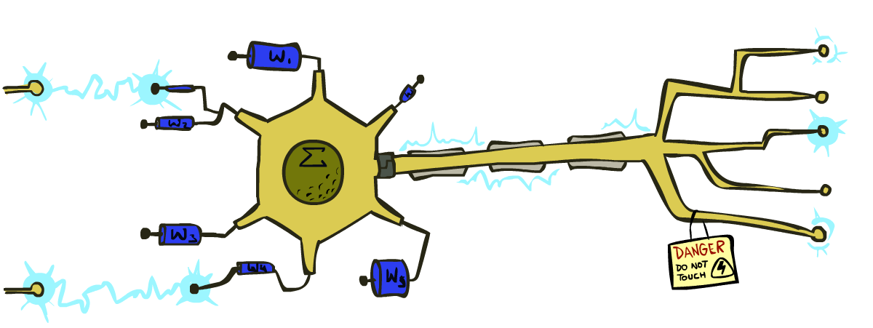
CSE 445: Machine Learning
Neural Networks
Instructor: Syed Athar Bin Amir, North South University

Slide 2
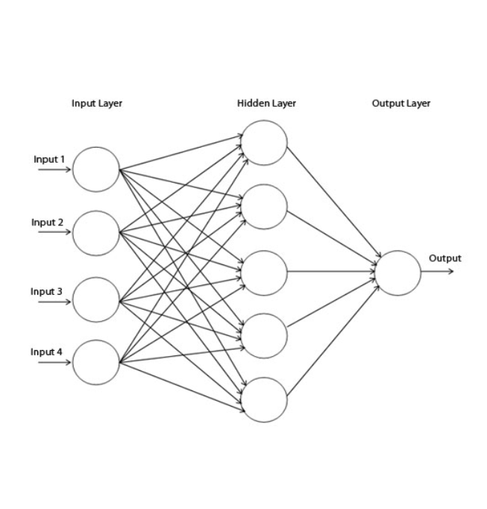
Neural Networks - Motivation
Neural Networks (NN) are biologically inspired – attempt to build computational models that operate like human brain
Makes no assumptions about the data – can be very accurate
Can be used in classification as well as regression
Black box model

Slide 3
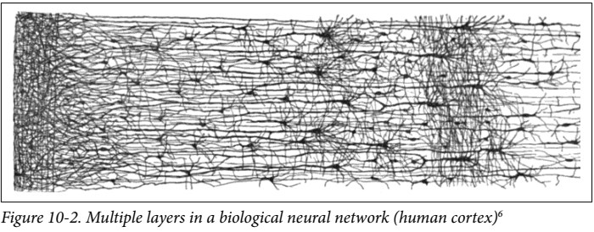
Biological Neurons
Receive multiple inputs from other cells via the dendrites
Fires an impulse output via the axon when a threshold has been met
Arranged in complex layers

Slide 4
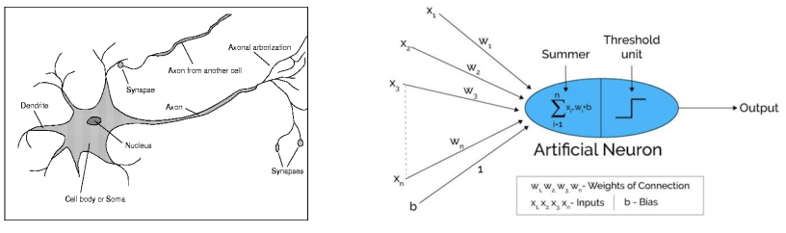
Artificial Neuron - Perceptron
Artificial neuron fires when the combined input exceeds threshold
Inputs and weights can be any value
Weights are learned
By itself, cannot solve the XOR problem – solution is to stack multiple layers, and use nonlinear activation functions
Notes:
http://www.asimovinstitute.org/neural-network-zoo/

Slide 5
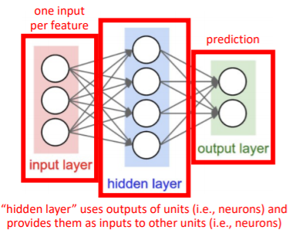
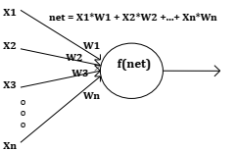
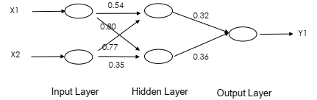
General Architecture – Neural Networks
Framework (in general, but not for all NNs)
Input Layer + Hidden Layer(s) + Output Layer
Weights
Activation Functions f(net)
Weights → initialized to small real numbers
Learning rule → determine how to update connection weights during each training cycle
Weight adjustment →based on errors/distance

Slide 6
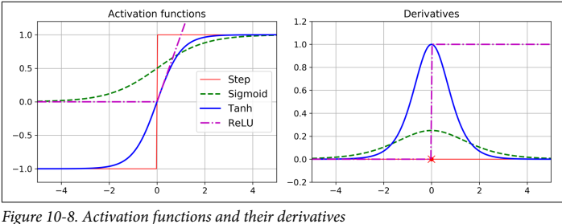
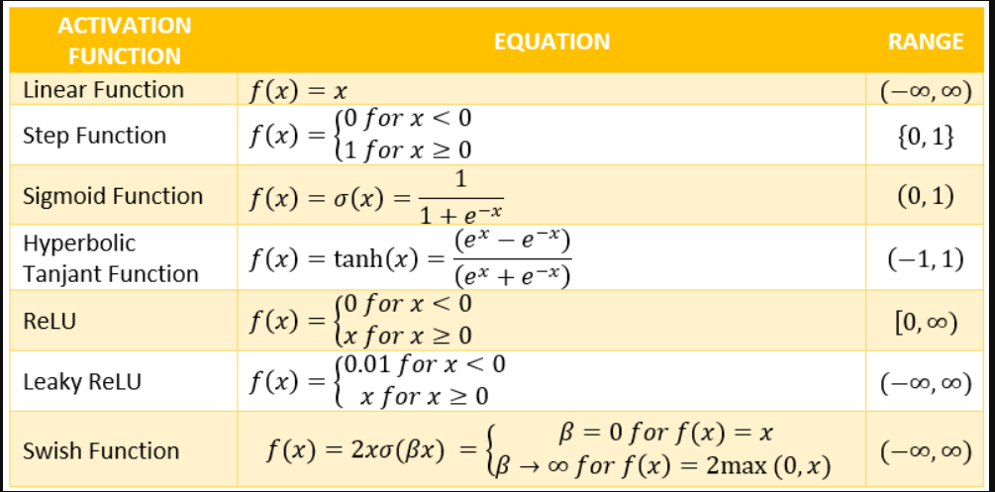
Activation Functions
Activation functions are nonlinear in nature, because:
Not possible to use backpropagation to train the model if linear
No matter how many layers, the last layer will still be a linear function of the first layer
Functions with a computationally inexpensive derivative (like ReLU) converge quickly, and are widely used
Important to avoid vanishing/exploding gradients problem!

Slide 7
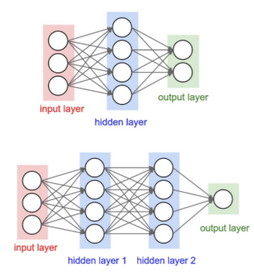
Fully Connected, Feedforward Neural Networks
Fully Connected → each unit in the network provides an input to each unit in the next layer
Feedforward → Each layer serves as input to the next layer, with no loops
If NN contains a deep stack of hidden layers → Deep Neural Network
How to train the network?
Answer: Backpropagation algorithm
Computes gradient of the network’s error with respect to every model parameter efficiently
Once the gradients are obtained, just a regular Gradient Descent step used to update params

Slide 8
Backpropagation
Initialize the weights to small random numbers
Randomly select a input and output pair (x,y) and present the input to the network. Compute the corresponding predicted output generated by the network. This is a FORWARD PASS.
Compute the error between the output generated by the network, and the true labels.
Propagate the “blame” for prediction errors back throughout the model, computing the error gradients with respect to each weight (thanks to chain rule!). This is the BACKWARD PASS
Update each weight using the gradients computed in #4 using Gradient Descent (recall Lecture #4)
If the stopping criterion is met (number of epochs, cost function threshold etc), you’re done! Otherwise repeat 2-5.

Slide 9
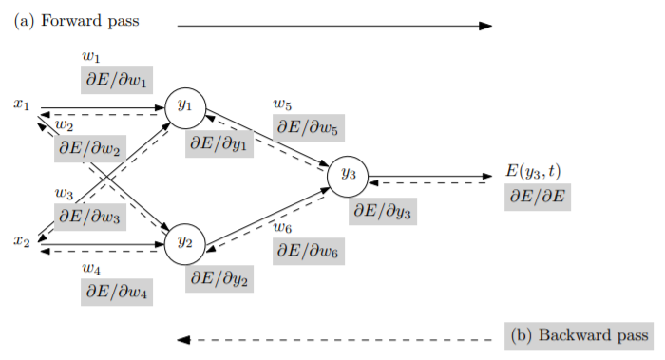
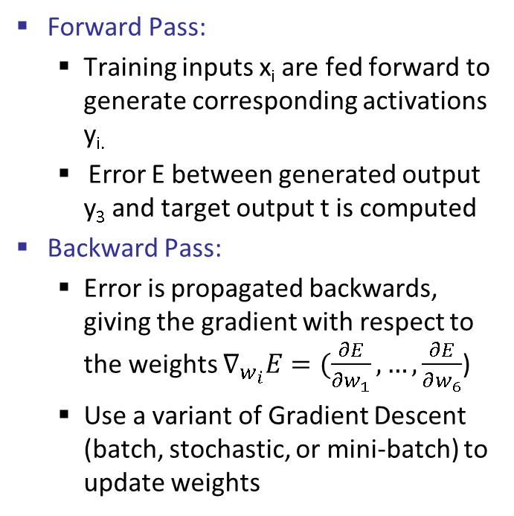
Backpropagation
Forward Pass:
Training inputs x_{i} are fed forward to generate corresponding activations y_{i.}
Error E between generated output y₃ and target output t is computed
Backward Pass:
Error is propagated backwards, giving the gradient with respect to the weights $∇_{w_{i}}E=(\frac{∂E}{∂w_{1}},…,\frac{∂E}{∂w_{6}}$)
Use a variant of Gradient Descent (batch, stochastic, or mini-batch) to update weights

Slide 10
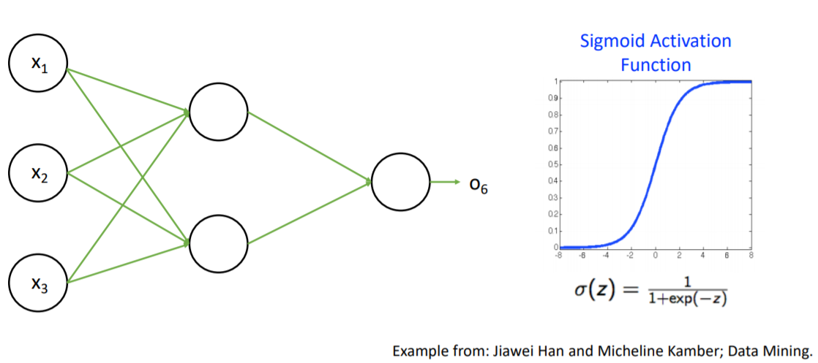
Backpropagation Example – NN Architecture

Slide 11
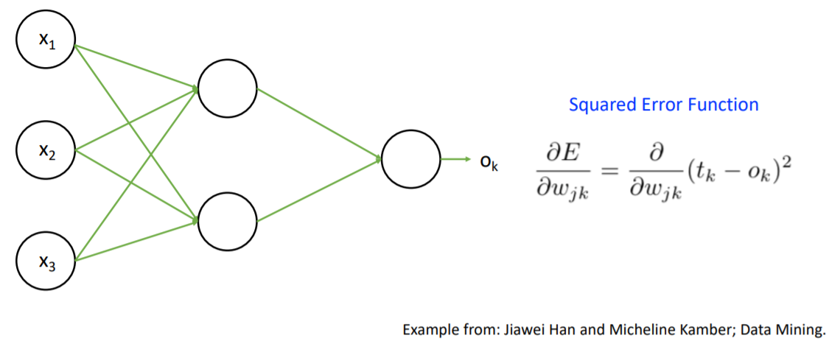
Backpropagation Example – Loss Function

Slide 12
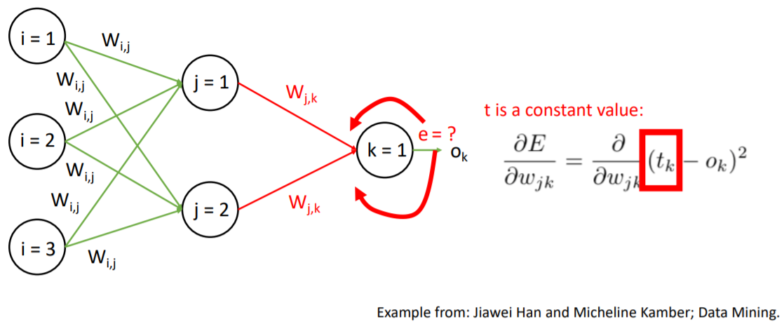
Backpropagation Example – Computing Gradient

Slide 13
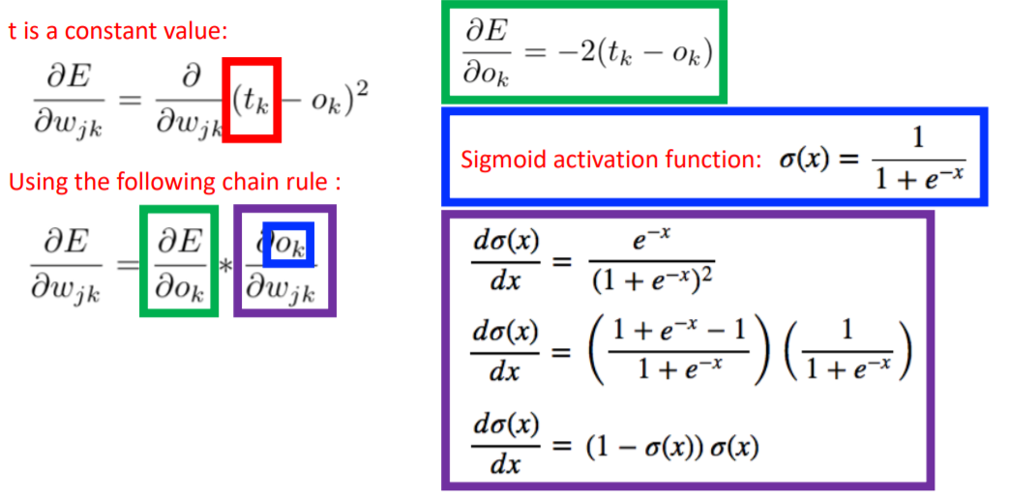
Backpropagation Example – Computing Gradient

Slide 14
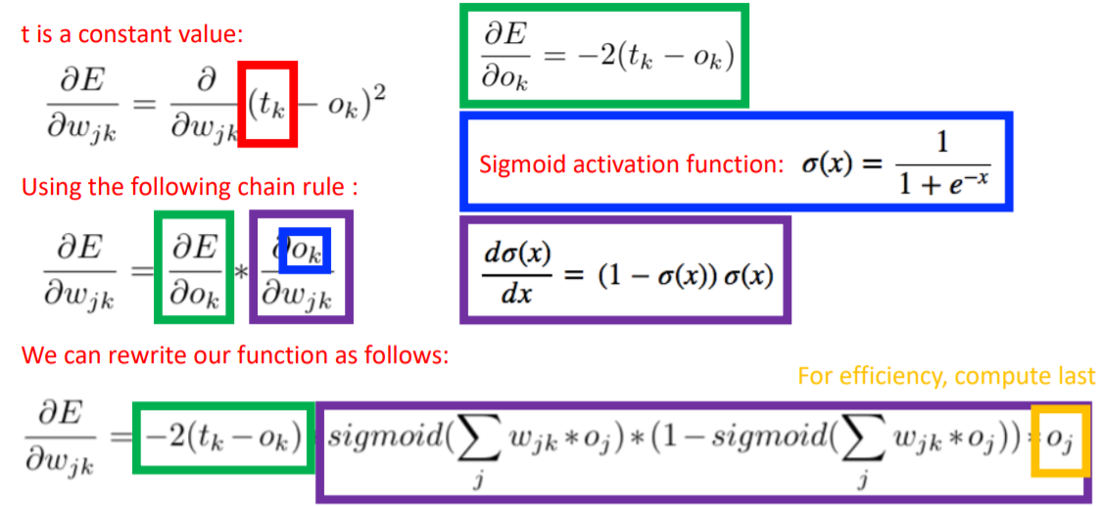
Backpropagation Example – Output layer gradient

Slide 15
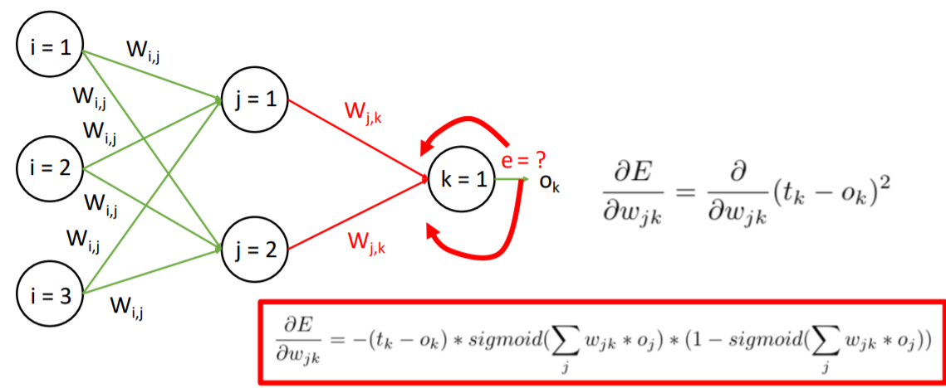
Backpropagation Example – Output Layer

Slide 16
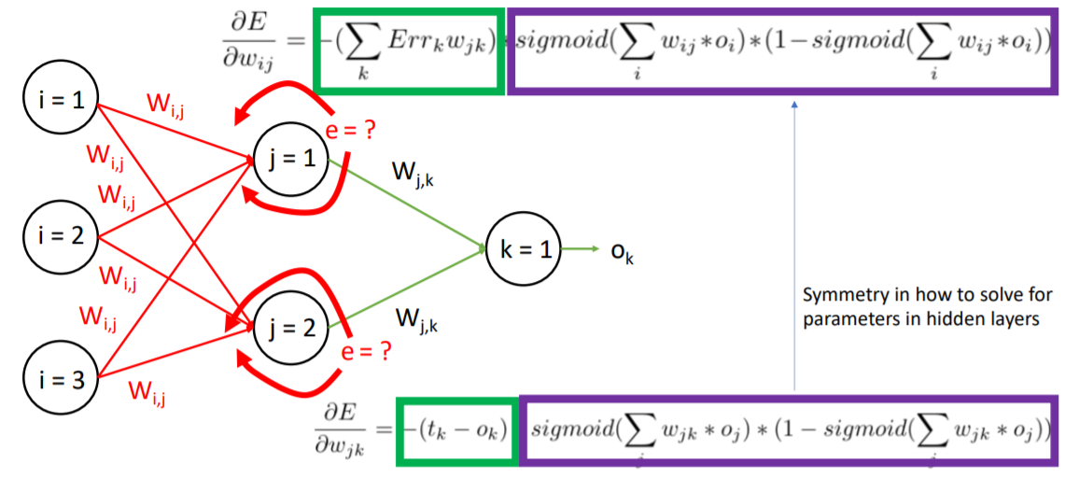
Backpropagation Example – Hidden Layer

Slide 17
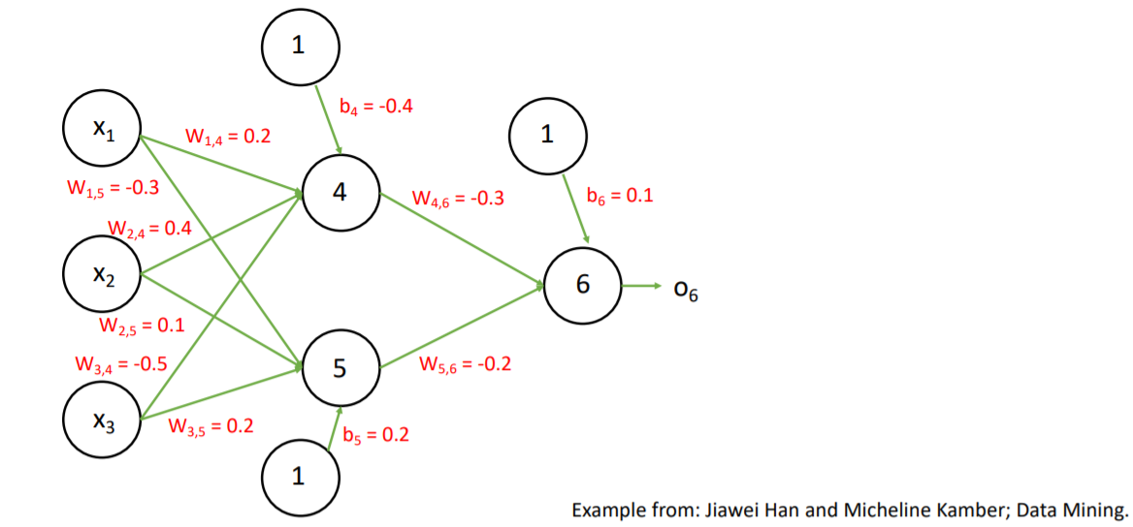
Backpropagation Example – Initial Values

Slide 18
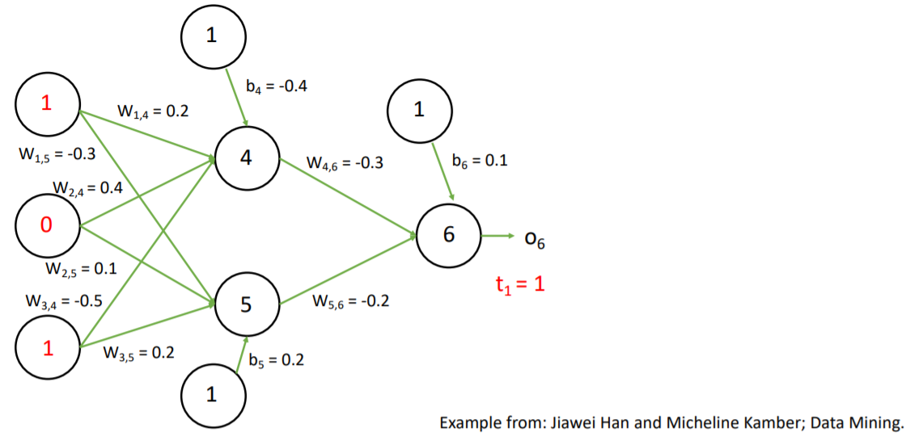
Backpropagation Example – Input Training example

Slide 19
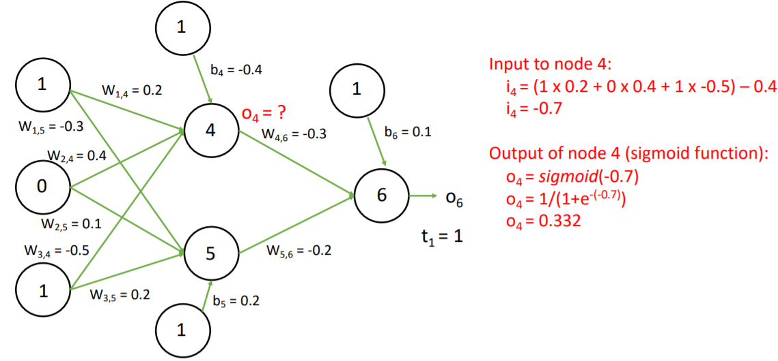
Backpropagation Example – Forward Pass

Slide 20
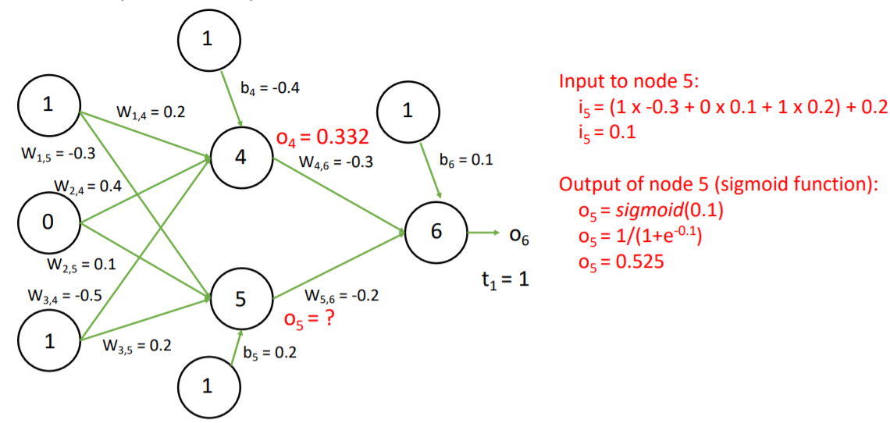
Backpropagation Example – Forward Pass

Slide 21
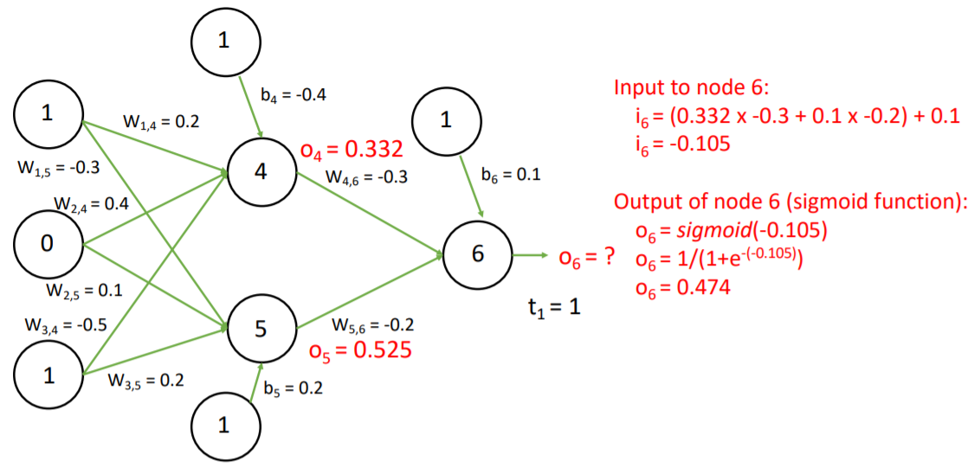
Backpropagation Example – Forward Pass

Slide 22
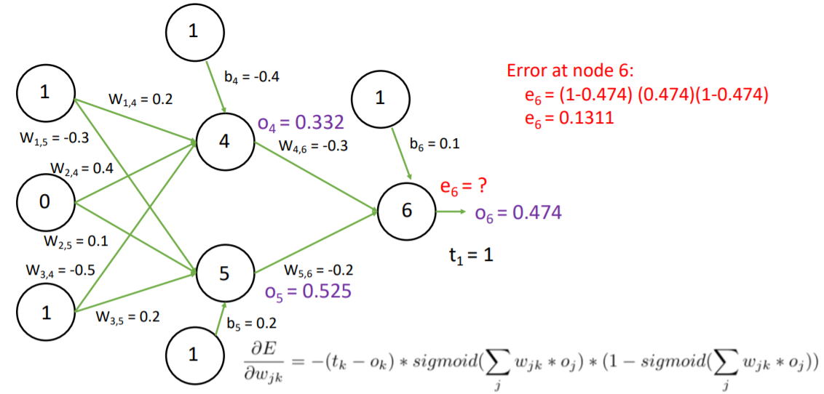
Backpropagation Example – Backward Pass

Slide 23
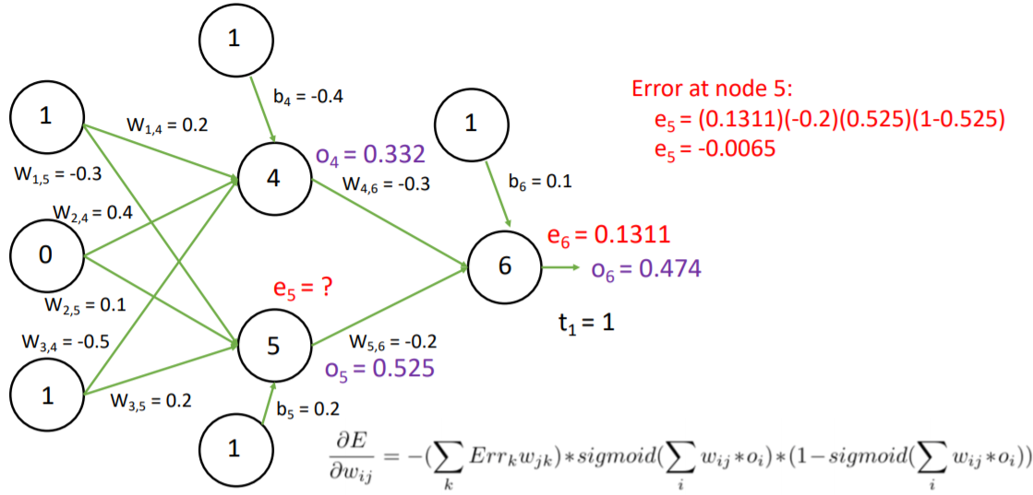
Backpropagation Example – Backward Pass

Slide 24
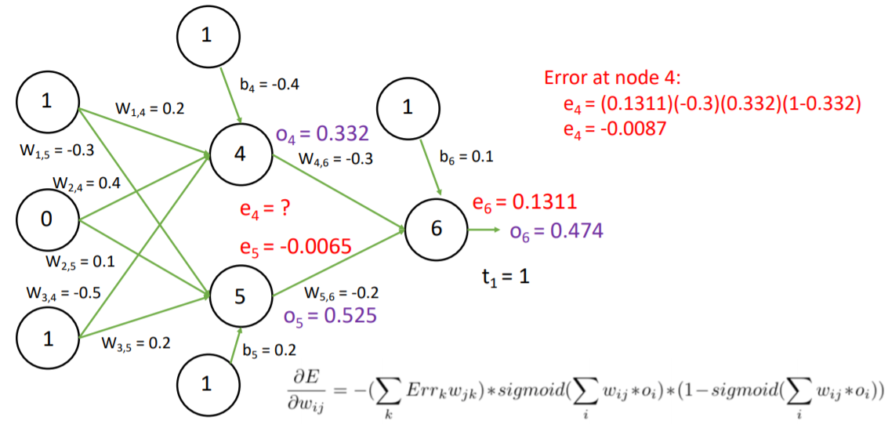
Backpropagation Example – Backward Pass

Slide 25
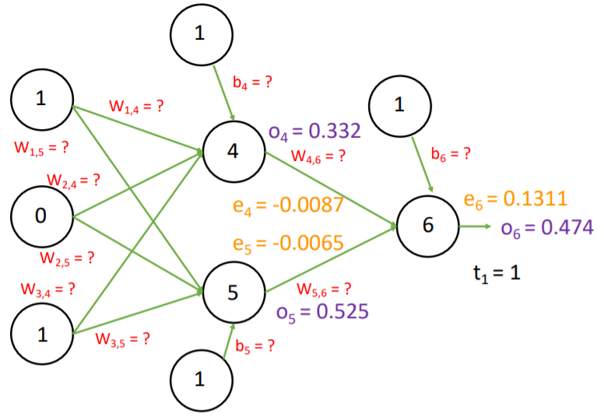
Backpropagation Example – Update Weights

Slide 26
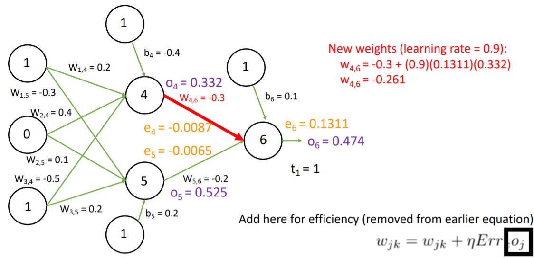
Backpropagation Example – Update Weights

Slide 27
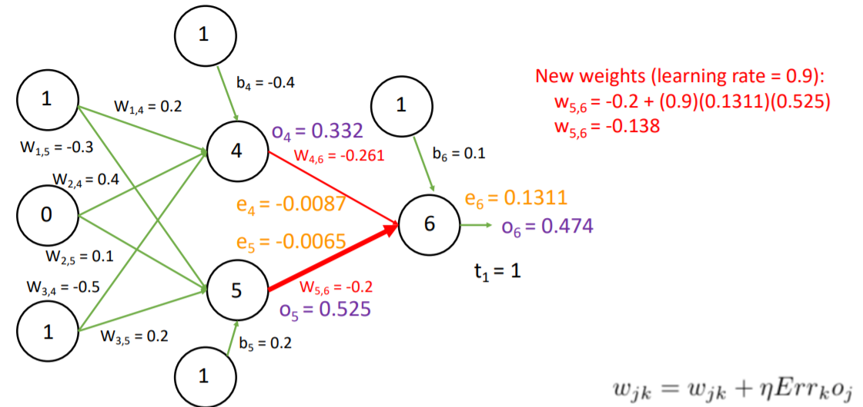
Backpropagation Example – Update Weights

Slide 28
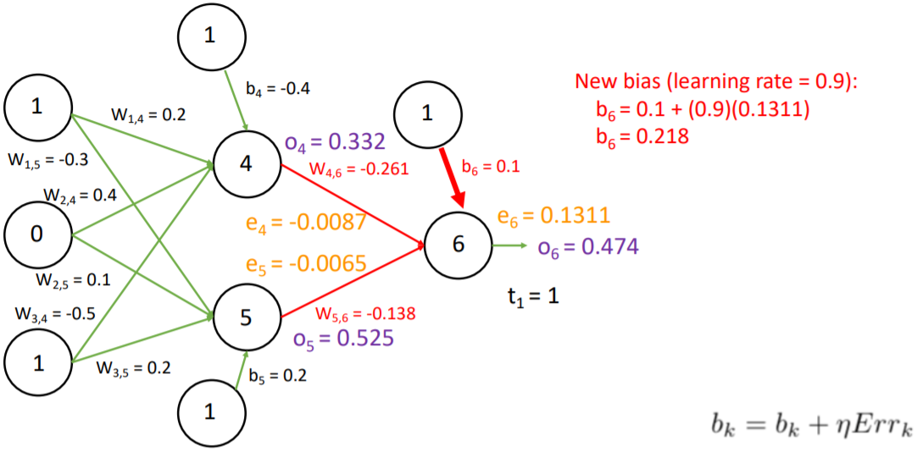
Backpropagation Example – Update Weights

Slide 29
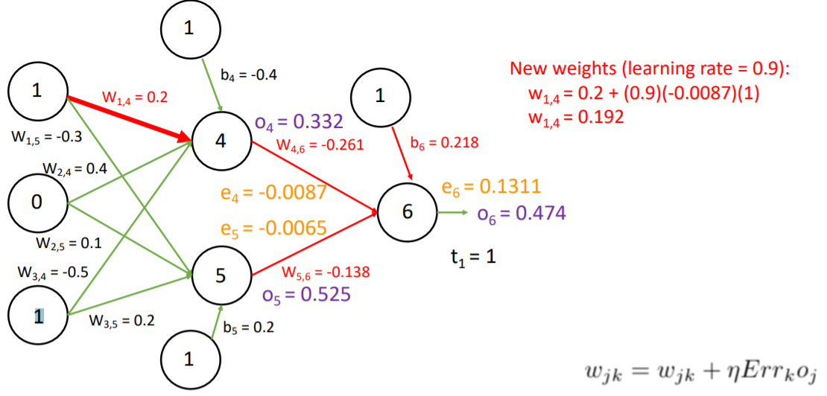
Backpropagation Example – Update Weights

Slide 30
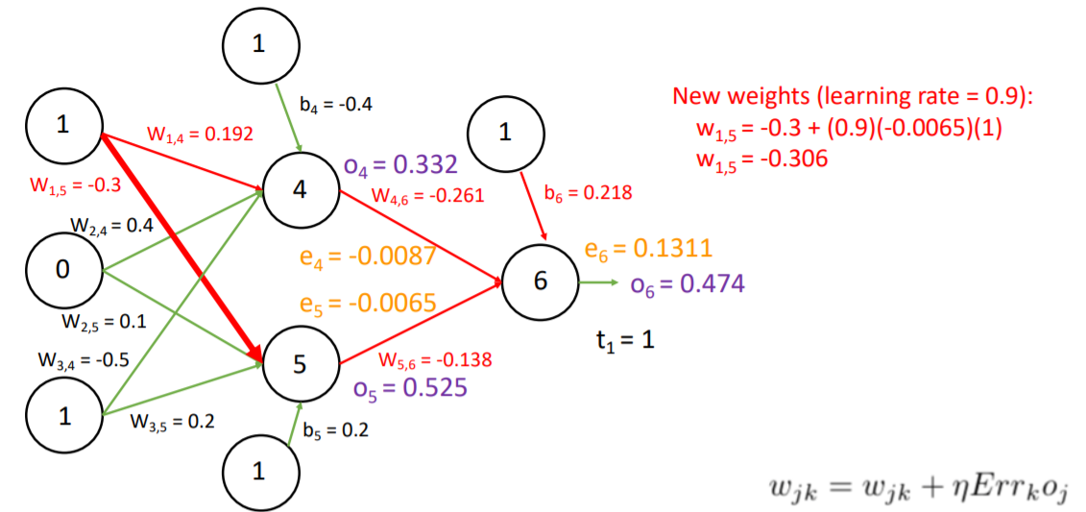
Backpropagation Example – Update Weights

Slide 31
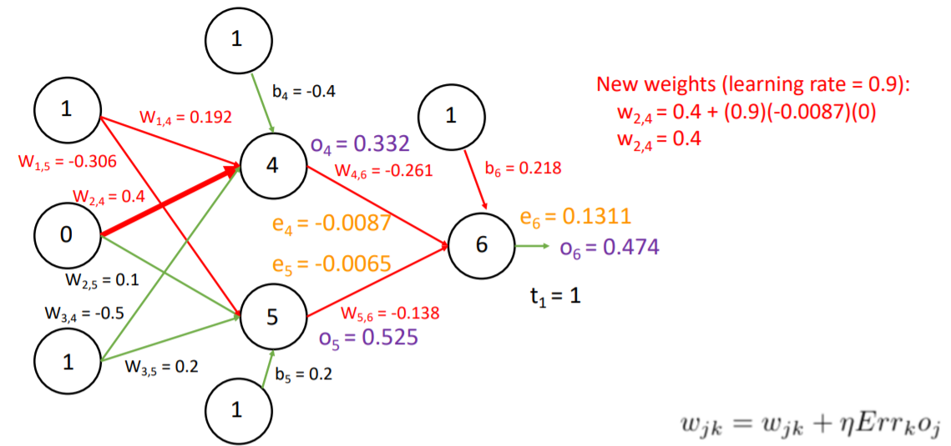
Backpropagation Example – Update Weights

Slide 32
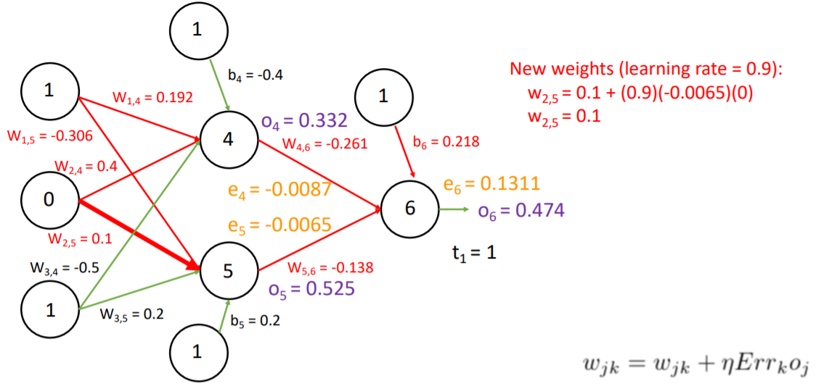
Backpropagation Example – Update Weights

Slide 33
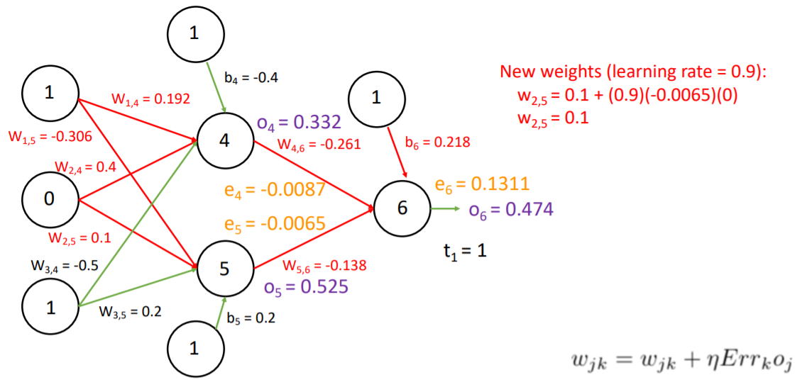
Backpropagation Example – Update Weights

Slide 34
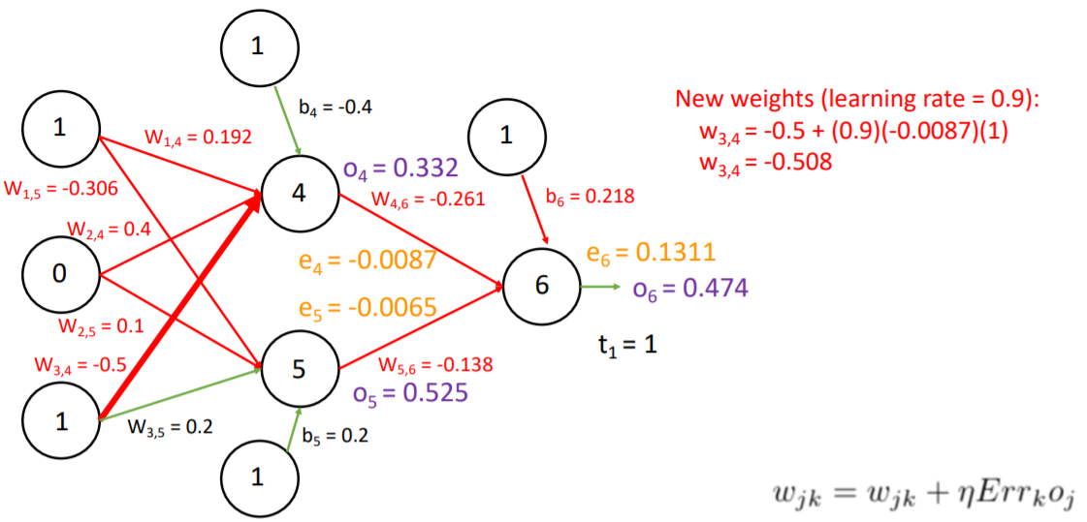
Backpropagation Example – Update Weights

Slide 35
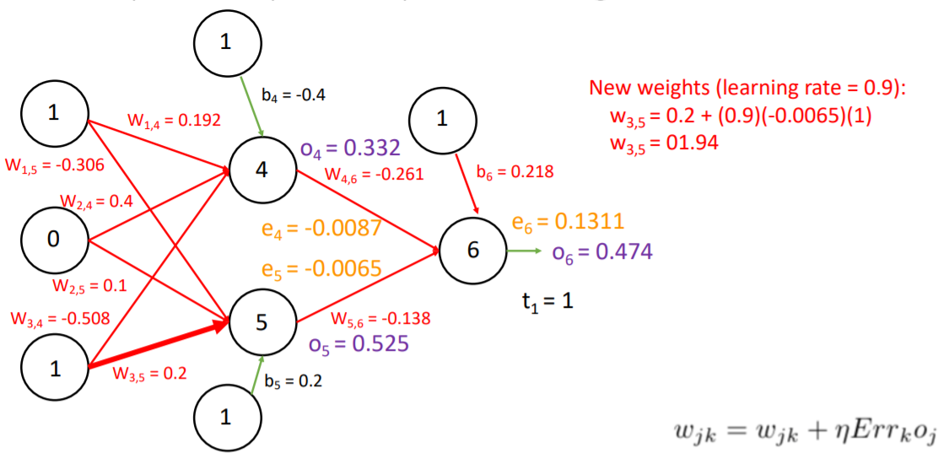
Backpropagation Example – Update Weights

Slide 36
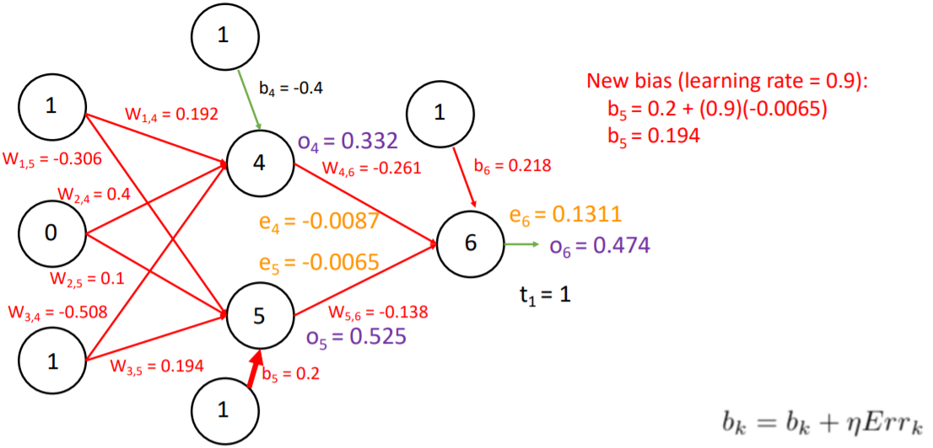
Backpropagation Example – Update Weights

Slide 37
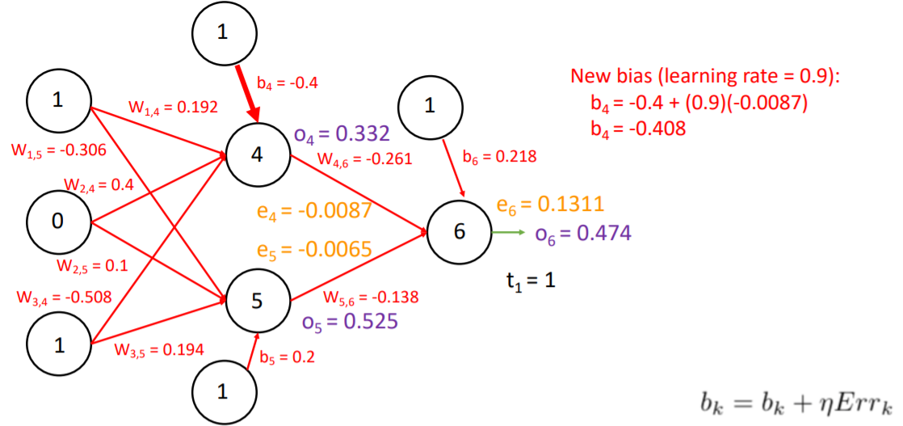
Backpropagation Example – Update Weights

Slide 38
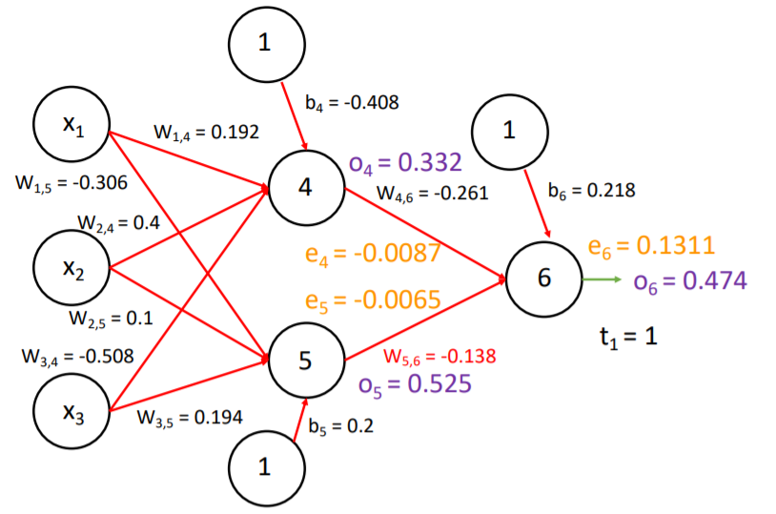
One iteration complete!

Slide 39
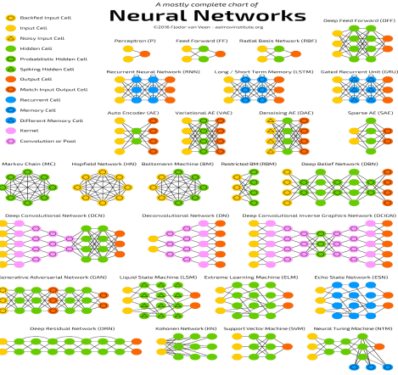
Some Notable Neural Network Architectures
Feedforward Neural Network (FFNN or DNN), as seen so far in examples. Others include:
Recurrent Neural Networks (RNN)
Long/Short Term Memory (LSTM)
Autoencoders (AE)
Convolutional Neural Networks (CNN)
Generative Adversarial Networks (GAN)
…and many, many more!

Slide 40
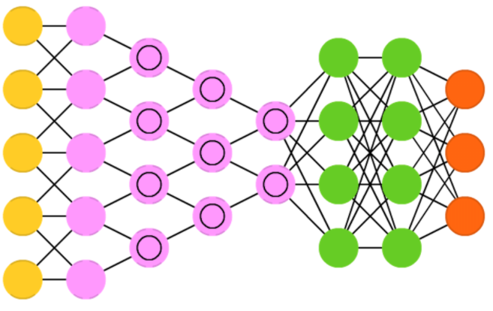
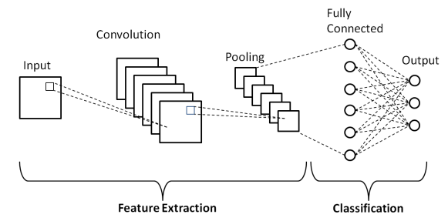
Convolutional Neural Networks (CNN)
Primarily used in image classification
Not a fully connected network – each node is only concerned with neighboring cells in convolutional layers
Convolutional layers perform convolution between the weights and the scanned pixels
Conv layers are followed by pooling layers (typically max pooling), which takes small regions of the conv output and takes the max value present
Typically terminates with a FFNN to the end

Slide 41
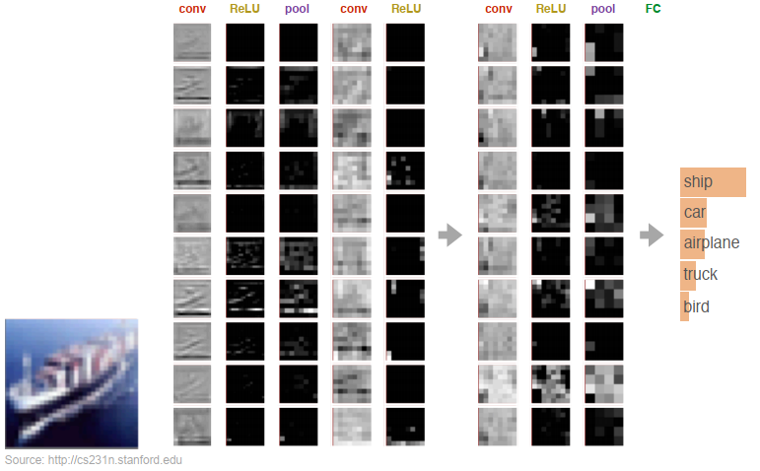
Convolutional Neural Networks (CNN)

Slide 42
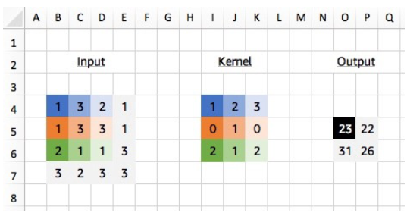
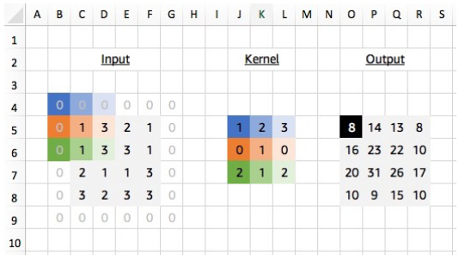
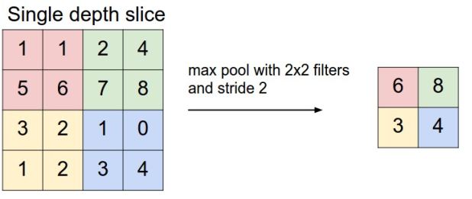
2D Convolution and Maxpooling

Slide 43
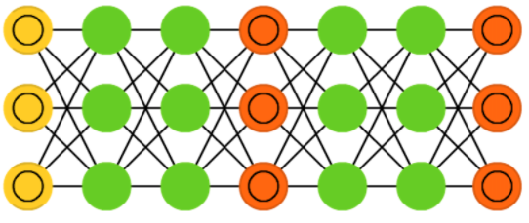
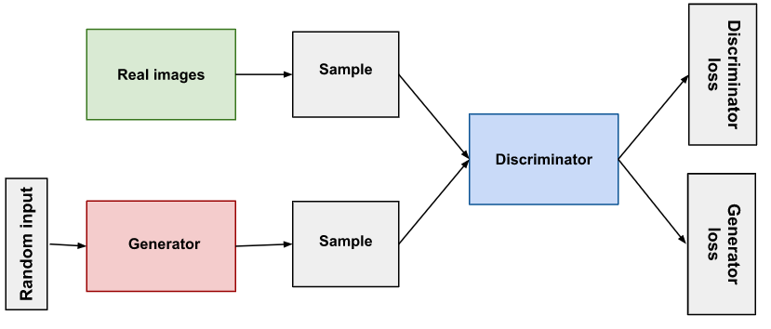
Generative Adversarial Networks (GAN)
Not one, but two networks (usually a combination of FFNN and CNN)
Generative network makes content, and discriminating network judges content
These two will compete against each other
Pretty difficult to train due to competing dynamics of the two networks
Generator does not train when discriminator trains, and vice versa

Slide 44



Generative Adversarial Networks

Slide 45

Discriminator (GAN)
Training data consists of real data (such as real pictures of people, positive class) and fake data created by the generator(negative class)
Generator weights stay constant while it produces examples for the discriminator training
During training, the discriminator:
Classifies both real and fake data from the generator
The discriminator loss penalizes the discriminator for misclassification
Discriminator weights are updated via backpropagation from the discriminator loss through the discriminator network

Slide 46

Generator (GAN)
Takes random noise as input, and produces meaningful output to fool the discriminator
Generator loss is produced at the discriminator → backpropagation starts at the output and flows back through the discriminator into the generator
Only the generator weights are updated from the gradients obtained from backpropagation → discriminator stays constant during generator training

Slide 47

Recurrent Neural Networks
Time twist: these are not stateless!
Neurons are fed information from the previous pass, as well as the previous layer
The order in which you feed the input and train the network matters as a result
Decent choice for advancing or completing information (e.g. your phone’s autocomplete)
Suffers from vanishing/exploding gradients issues

Slide 48

Long/Short Term Memory (LSTM)
Instead of using recurrent cells (that have feedback from past inputs), LSTM uses explicitly defined memory cells to counter the vanishing/exploding gradient issue
Each neuron has a memory cell and three gates: input, output, and forget
Has been shown to learn complex sequences (such as composing music)

Slide 49

Autoencoders (AE)
Basic idea is to compress information via this architecture
Hourglass shape – everything before the middle used for encoding, and after is used for decoding
Can train with backpropagation and see if the output cells generate the input back

